Slide 1
Undergraduate Research Fellows
A STUDENT/TEACHER COLLABORATIVE RESEARCH PROGRAM
Sexual Abuse at Historically Black Colleges and Universities (HBCU)
Student: Victoria Walters
Faculty Mentor: Ms. Donna Bradby

Slide 2
Proposal
This project will include data from pre and post surveys, likerd surveys, video and emailed testimonials that will serve as justification to use Mad at Miles as an integral training tool to combat sexual assault and domestic violence in classrooms across campus. We will share this research data with the university's domestic violence and sexual assault taskforce/committee, Counseling Services, University Police and Security, and the Student Government Association.
  To have Touring Theatre of North Carolina’s production of Mad at Miles embedded into the new students’ academic curriculum. Early intervention is key to prevent sexual abuse at HBCU’s and this can be accomplished by requiring that this project be completed by everyone entering college.
  To target university fraternities, athletics, clubs and groups that are predominantly male with the goal of creating advocates who will educate their counterparts and mirror behavior that will led to societal change.
  To equip all female students with the knowledge of how to recognize and respond to an abusive relationship and to help lift other women who are dealing with the same problem.
  To create a bridge of trust between our community of student’s, campus police and security, faculty, staff and university administration.`

Slide 3
Sexual Abuse
In this day of age, sexual abuse is an ongoing subject
  Topics such as #MuteRKelly, #MeToo, and #TimesUp are very present and young girls are most likely to be targeted

Slide 4
Sexual Abuse on Campuses
Woman in College are 3x as likely to be at risk of sexual abuse then the average woman
40% of African American women report sexual contact by age 18
1 out of 5, or 20%, HBCU women will experience sexual assault, which is the same rate at Predominately White Institutions (PWIs)
40% of cases reported are not investigated by Colleges and Universities

Slide 5
Mad at miles: a black woman’s guide to truth by Pearl Cleage
Music can be expressive and powerful, beautiful and fierce. So can a woman. Mad at Miles follows three women on an emotional journey through the anger of abuse to the clarity of self-discovery. Even as they grapple with the discordant realities of relationships, sex, and violence, they learn to find peace in the melody of their own voices.
Set against the backdrop of Miles Davis and Cicely Tyson’s troubled marriage, these alternately passionate and poetic stories explore love, pain, and where to draw the line between a man and his music. [It’s not man bashing; it’s love.] This is a funny, angry, lyric piece of theatre that all college-aged men and women should see.

Slide 6
Touring Theatre of North Carolina
Touring Theatre of North Carolina is a not for profit, active producing professional theatre that celebrates the on-going human search for dignity across lines of ethnicity, gender, economic status, religion and age.
Touring Theatre is a Laboratory: It looks for local stories. It develops and premier’s new works drawn from literature, historical documents, and from people within its community. Most years premiers three new works in its Chamber Series, introducing one or two of them into its touring production inventory.
Touring Theatre is Collaborative: It collaborates with community organizations, groups, scholars, educational institutions and others who are engaged in the subject matter being presented in order to produce the most relevant and authentic work.
Touring Theatre is Local: It gathers stories of local relevance and is firmly rooted in the central North Carolina community. All its productions are developed and premiered in Greensboro, NC, before becoming available for touring.
www.ttnc.org

Slide 7
Pearl Cleage
Pearl Cleage is an African-American poet, essayist, and journalist living in Atlanta, Georgia. An activist on issues including AIDS, women's rights, and black life, her first novel, What Looks Like Crazy on an Ordinary Day (1997), was an Oprah Book Club selection and appeared on the New York Times best-seller list for nine weeks.
Drawing not only from her own personal experiences with abuse but from the harrowing stories of countless women around her, writer Pearl Cleage was driven to write what she considered a workbook for black women struggling to survive in a society that is both racist and sexist. What she ended up with was a collection of essays and performance pieces called Mad at Miles: A Black Woman’s Guide to Truth. Cleage’s passion and courage to speak out against a musical icon like Miles Davis was the catalyst for this amazing piece of theatre.

Slide 8
Miles Davis
Miles Davis was a Jazz music genius, there’s no question about that fact. His albums, Kind Of Blue is a masterpiece; Bitches’ Brew is probably one of the most important albums of its era, combining jazz and rock influences into something entirely new. He was also a monster.
Miles Davis beat his wives with regularity, by his own admission. And in a rare interview with The New York Times, his first wife, Frances Davis, recalled, “I actually left running for my life—more than once.” These days, his history of abusive behavior has been largely forgotten or rationalized. Davis was a man with demons, and those demons fueled his music into being an expression of love, rage, and ego. He had the potential to be a cruel, brutal man, and he knew it.

Slide 9
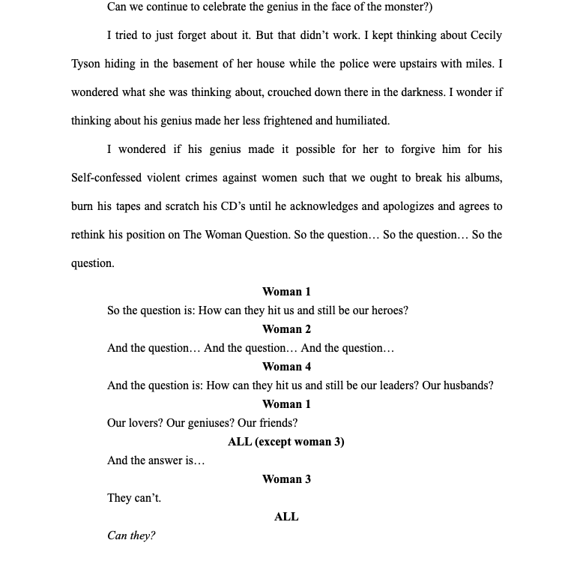
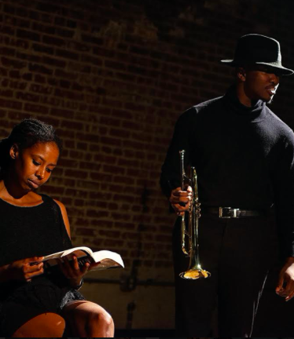
Mad at Miles
The character in this piece reluctantly exposes the monster behind the music and why she is so Mad at Miles.
She continually proclaims that “He is guilty of self-confessed violent crimes against women such that we should break his albums, burn his tapes and scratch his CD’s until he acknowledges and apologizes and rethinks his position on The Woman Question.” Almost driving herself to the point of insanity while asking the questions.

Slide 10
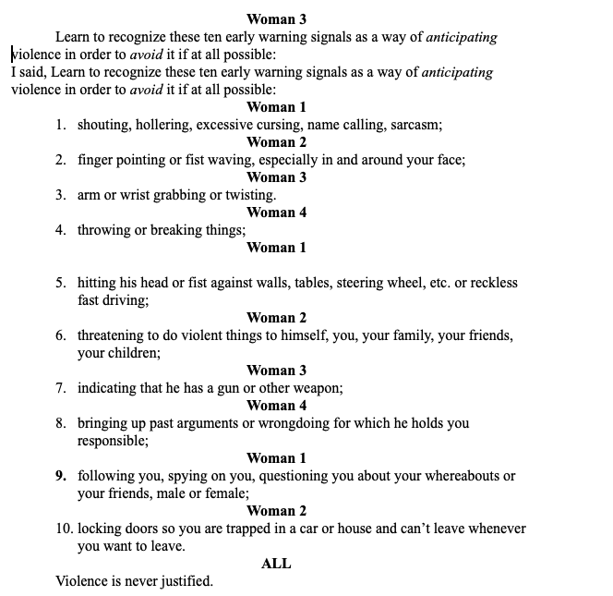
Basic Training; facts of life
Female Gang Members aggressively school the audience about what it’s like to be an African- American female in America.
The characters move from gang members, to soldiers, to drill sergeants, always keeping it real about sexism, racism and abuse.
Armed with bats, chains, knives and M-16 assault rifles, while adorning military camouflage this piece is a wake-up call to all young females to be knowledgeable and prepared.

Slide 11
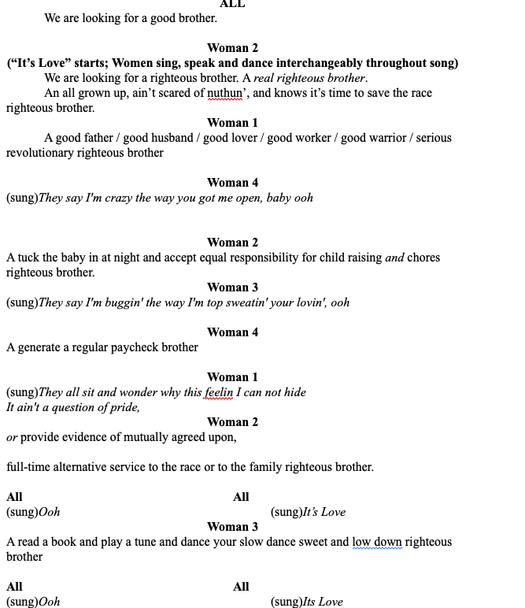
Good Brother Blues
Good Brother Blues is a Love Song to the Brothers.
This piece gives the Brothers some insight into exactly what Sisters want. Jill Scotts hit song “Its Love” is the musical accompaniment as the Sisters lovingly give the Brothers a working definition of who and what they are looking for, “We are looking for a Good Brother.”

Slide 12
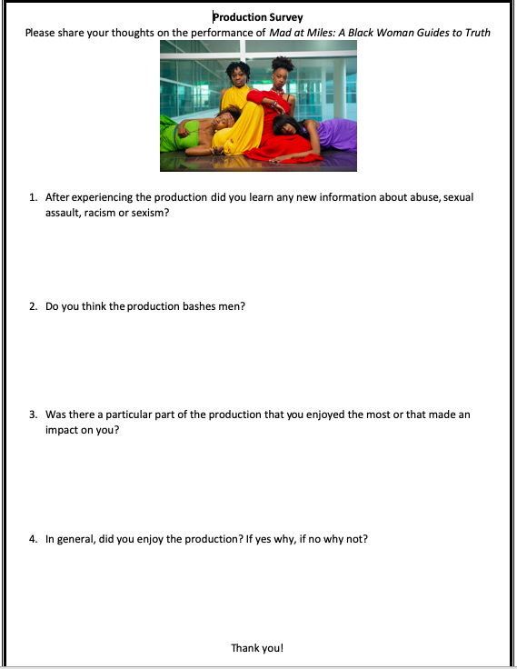
Post Survey
Performed Mad at Miles for three groups
  2 Acting for non- major classes
  1 Stage Management Class
We gave the option to fill out the post survey:
  42 students filled them out
  29 were female 13 were male
Out of 42 students
  15 acting
  10 psychology
  6 Biology
  5 Criminal Justice
  6 JOMC
Survey on When This should be Performed
  Highschool- 40%
  Freshman (College)-60%
  Upperclassmen (College)- 0%
  Adult- 0%

Slide 13
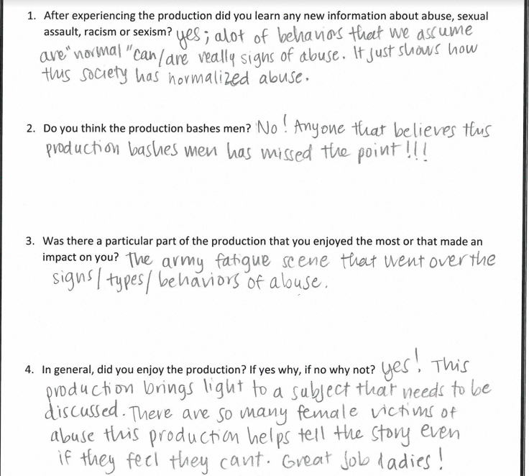
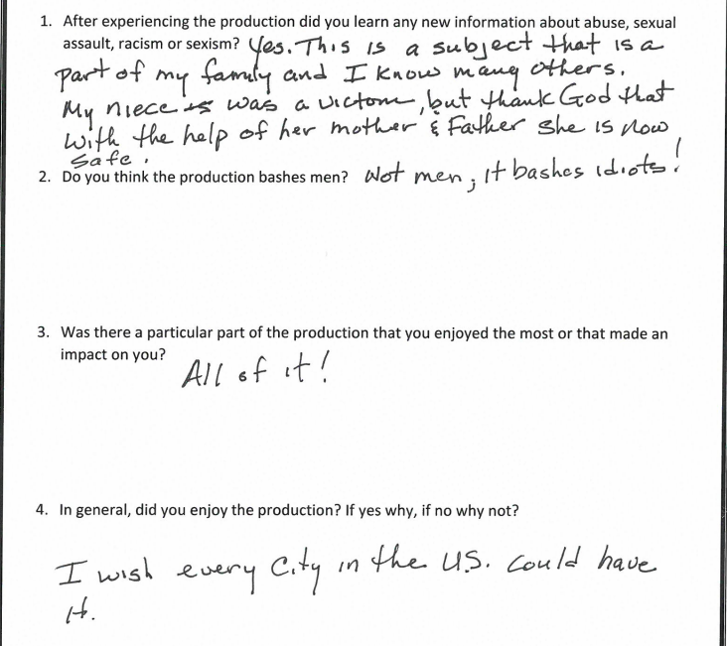
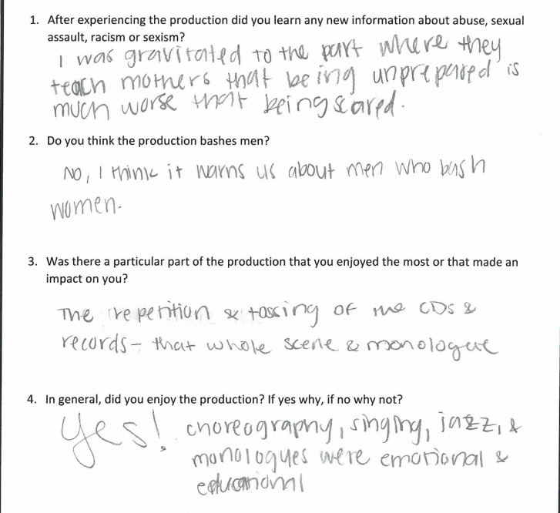
100% of surveys said yes to the first question
94% of surveys said no to the second question
98% of surveys said yes to the fourth question
60% knows someone who was sexually assaulted while attending a HBCU
10% knew that all 10 basic training facts were signs to recognize abuse
55% said yes if they knew, it could be avoided
30% said maybe
15% said I don’t know

Slide 14
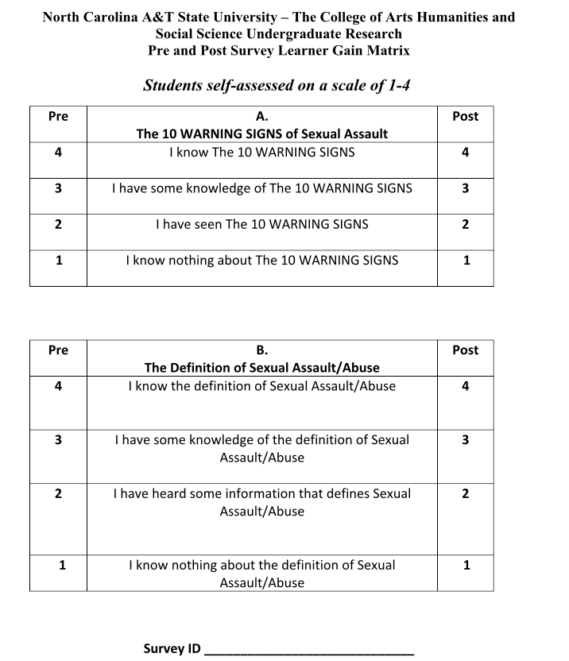
The Lost Scenes
We were unable to perform Mad at Miles for several of our targeted audiences due to COVID-19. They were the following organizations and classes:
  An A&T all Male Fraternity
  A&T’s Men on the Move
  Sociology and Social Work 400 - Intimate Partner and Domestic Violence Classes
Our Learner Gain Matrix Tool would have been used to collect data showing learning gain focusing on the areas of sexual assault and abuse based on experiencing a performance of Mad at Miles.
The New Direction:
Send a video recording of Mad at Miles, Facts of Life/Basic Training and Good Brother Blues to a group of A&T male college students and administer the Learner Gain Matrix and the research will be conducted by May 25, 2020

Slide 15
Learner Gain Matrix
The learner gain tool is designed to be administered before the performance and
then afterwards to track if viewing a performance increased the participants
knowledge of specific issues presented in the production. This tool was unable to
be administered.

Slide 16
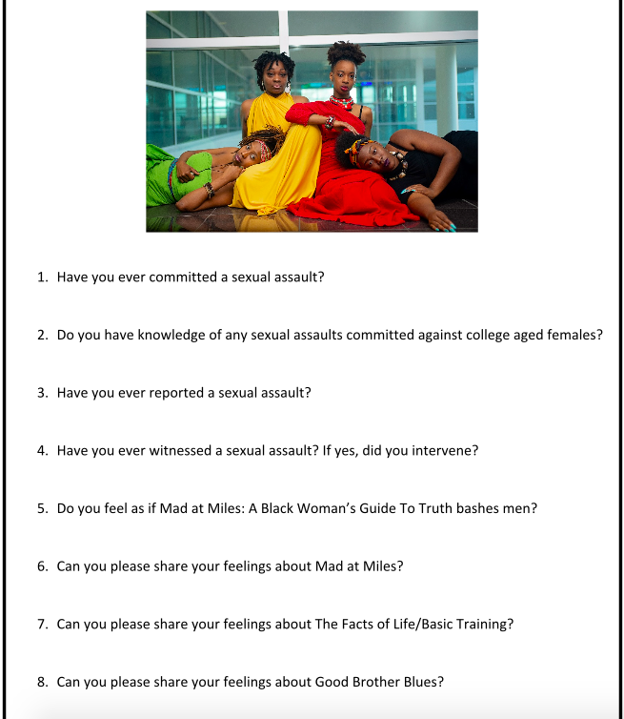
Creating Advocates
The learner gain and this survey tool is designed to create a generation of male advocates.
Advocates are people who publicly and privately supports, fights for, and actively recommends how to change, and reinforce a particular cause or policy.

Slide 17
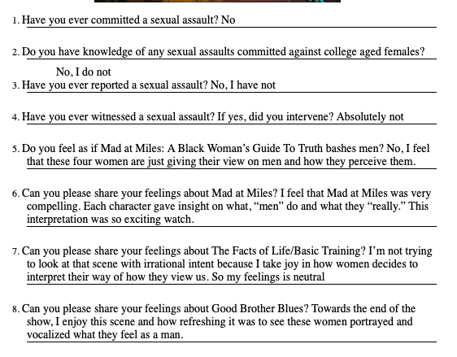
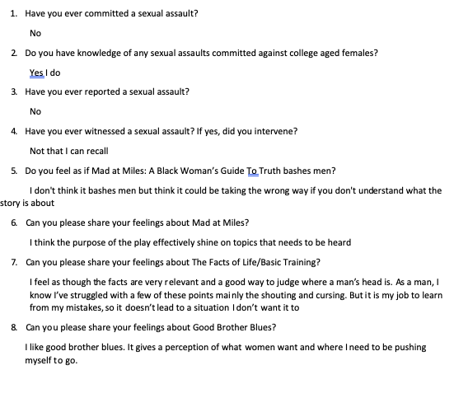
Survey Tool for Mad at Miles Males
We were unable to create a video of Mad at Miles because of the stay at home order due to COVID 19. This video was specifically for the male demographic we targeted for the study. To obtain the data needed we decided to reach out to male students who saw the Welcome Week performance in Fall 2019 of Mad A Miles: A Black Woman’s Guide To Truth at Paul Robeson Theatre. We were able to contact 10 of those male students and they agreed to complete the survey. Two of their feedback is below:

Slide 18
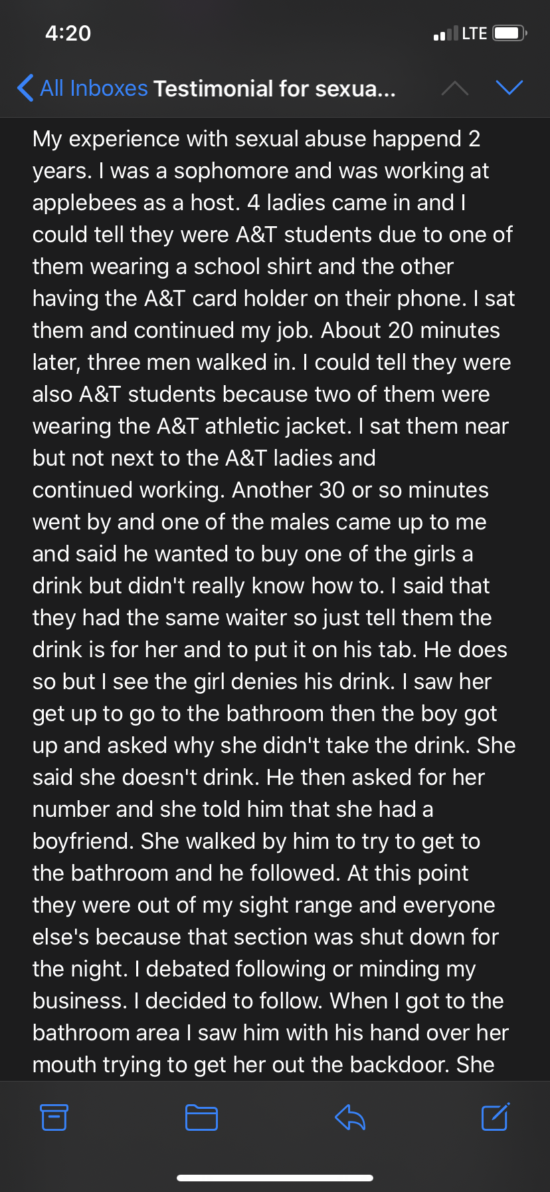
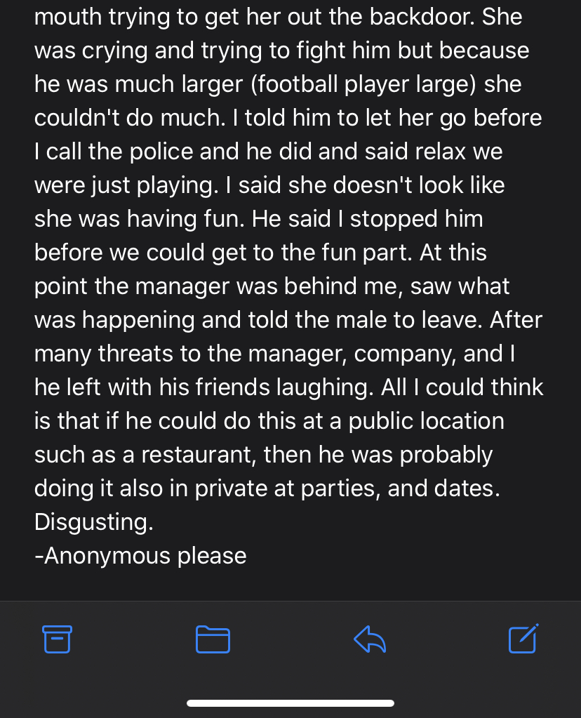

Testimonies
We were able to get two testimonials from females at North Carolina A&T

Slide 19
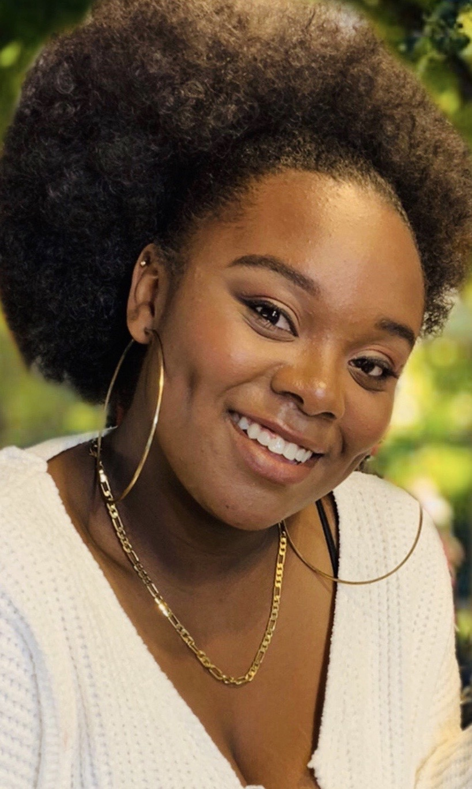
We thank you for all of your feedback. Ms. Donna and I have talked extensively about how to find funding, write proposals, and market it to other universities. We believe this grant has given us the data and the opportunity to reimagine the production as more than just a traditional hour-long theatre performance and evolve it into a training tool. I have also been told by parents that it should be in high schools. We plan on aggressively creating modules, workshops, study guides, curricula, assessment, and evaluation tools. We want to partner with universities counseling services, women’s studies, fraternities and sororities and the list goes on. This undergraduate research funding has really been a major springboard for this project. We were so grateful for this opportunity.

